Slide 1
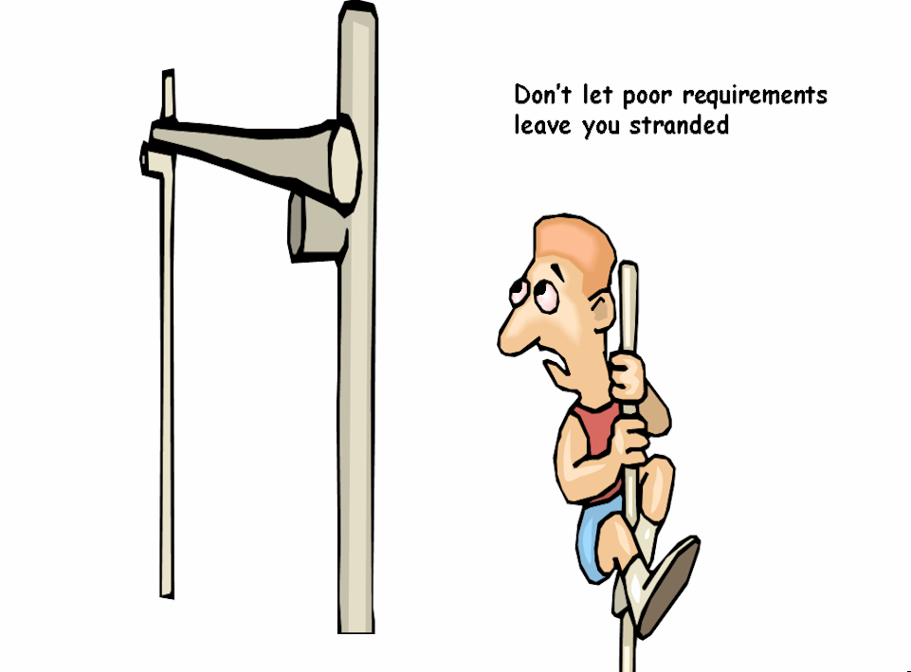

Slide 2


TopTeam Analyst
TM
A unique Requirements solution
TechnoSolutions Confidential. Not for public distribution without express permission.

Slide 3
Life Cycle of a
Software Project
Notes:
Showing again due to popular demand
We have heard of waterfall life cycle, spiral life cycle, sawtooth development….this is a typical life cycle that you may have encountered

Slide 4
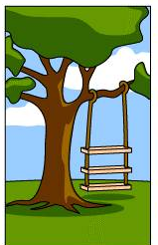
How the User explained it

Slide 5
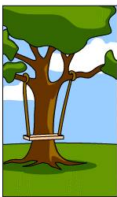
How the Analyst understood it

Slide 6
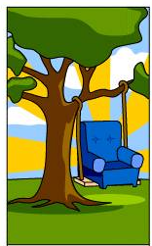
How the sales consultant described it to get the contract

Slide 7
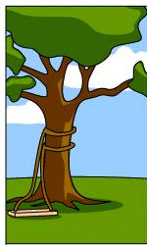
How the programmer wrote it

Slide 8
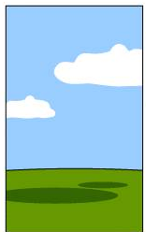
How the project was documented

Slide 9
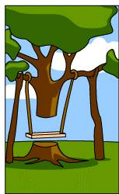
How the system was installed at Customer’s site

Slide 10
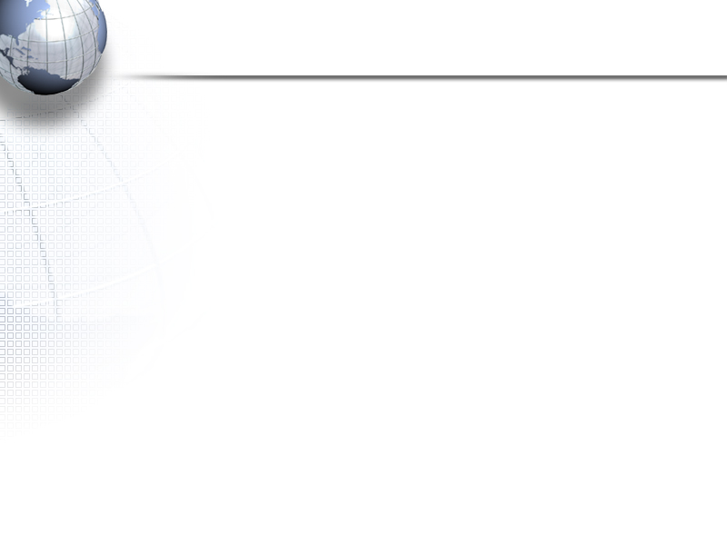
Favorite one

Slide 11
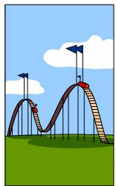
How the Customer was billed

Slide 12
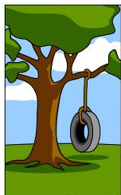
What the poor User really needed

Slide 13
Problem Domain
Solution Domain
Features
Requirements
Use Cases
Subsystems
Modules
User Needs

Slide 14
How do you Capture and Manage Requirements?

Slide 15



Requirements Gathering Process is Often Ad hoc
The emailed Requirement
The water cooler Requirement
“Hey can you add this feature on that form”
The “meeting” Requirement
The “Specifications Document” Requirement

Slide 16
So what is the problem?
Requirements have a long life cycle
Requirements are used by many different stakeholders on a project
  “Emailed requirements” get buried and lost
  “Water cooler requirements” go straight to the code
  Minutes of the meeting and Requirements document – Often not maintained.
  Also who has latest version of the Requirements document?

Slide 17
The Requirements Life Cycle

Slide 18
Requirements Life Cycle
Gather
Analyze
and
Document
Prioritize
&
Scope
Communicate
Implement
Test
Develop
End User
Documentation

Slide 19
Who needs Requirements?

Slide 20

Consumers of Requirements
Product
Manager
Analyst
Project Manager
End User,
Customer
Requirement
Developers
Technical Writer
(Documentation)
QA

Slide 21
Why Manage Requirements?

Slide 22
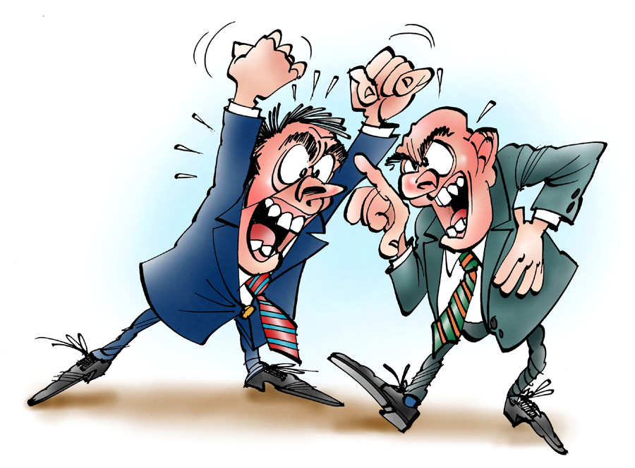
To avoid this
Notes:
For next slide…… or we want to avoid this this…

Slide 23
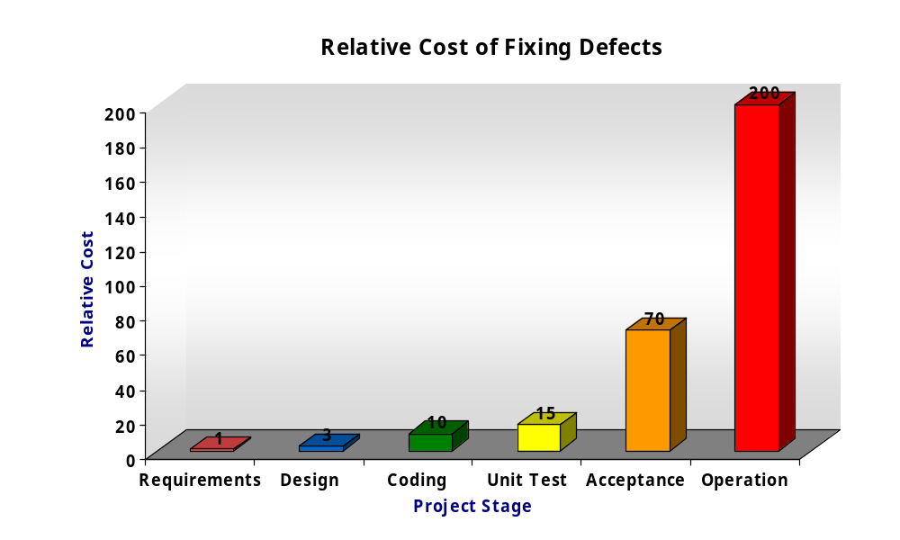
As much as a 200:1 cost savings results from finding errors in the requirements stage versus finding errors in the maintenance stage of the software life-cycle.
Source: Boehm, Barry W., Software Engineering Economics : Study of 63 projects from IBM, TRW, GTE etc.

Slide 24
Desirable - Rate of discovery of errors
Rate of Discovery
Proposed
Current
Requirements
Design &
Build
Release
to Test
Release
to Field
TIME
100X Decrease in Cost of Removing Defects
Notes:
Intro to next slide…. We want to avoid this

Slide 25
Can you afford not to?
Barry Boehm- ‘76, 88
56% of all bugs can be traced to errors made during the requirements stage

Slide 26
Different “Requirement Types”
Needs
Features
Software
Requirements
Performance
Requirements

Slide 27
Requirement Types
Needs
  (e.g. Business Needs, Market Requirements, Product Requirements)
  Described in the language of “Business”, “Customers” or “End User”
  Excellent for communicating with users, particularly during the initial phase of the project
Features
  List the functionality of the system
  Excellent for Prioritizing, Scoping and for planning Releases

Slide 28
Requirement Types
Functional Requirements
  Describe in detail the functionality of the system
  Also called System Requirements, Software Requirements, etc.
  Needed for developers and testers
Non-Functional Requirements
  Describe constraints or non-functional qualities of the system
  E.g. Security Requirements, Safety Requirements, Performance Requirements, etc.

Slide 29
TopTeam Requirements Repository
Requirements
Use Cases
Requirements
Repository
Diagrams
Screen Prototypes
Documents
Trace relationships
Business Rules

Slide 30
TopTeam Requirements Repository
Versioned
Multiple users can simultaneously read and write
Access can be controlled by granting privileges
TopTeam
Requirements
Repository

Slide 31
TopTeam Requirements Repository
San Francisco
LAN
TopTeam
Requirements
Repository
Internet
New York
Internet
London
VPN
Internet Enabled
Sydney
Multiple Time Zone Capable

Slide 32
Demo
Creating and Editing
Requirements
Requirements Tree
Requirements Document View

Slide 33
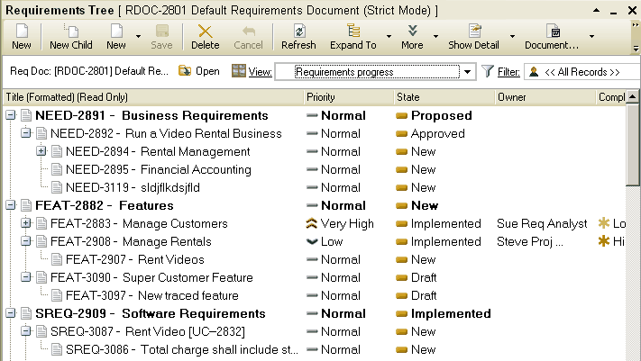
Organize ‘Requirements’ hierarchically and specify life cycle status and other important attributes

Slide 34
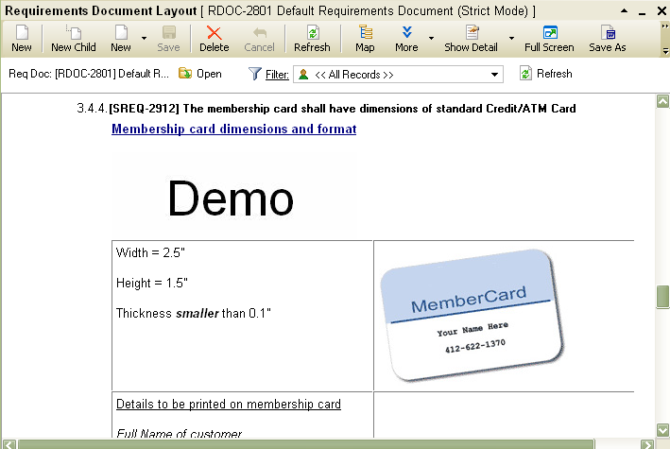
Exclusive - WYSIWYG Requirements Editor with full Rich Text editing capability

Slide 35
Specify Requirement Attributes and use them to Sort, Group, Summarize Requirements
User Need
User Priority
Implementation Priority
Size
Complexity
Risk
Stability
Cost and Hours

Slide 36
Requirement Quality Factors
Unambiguous
Complete
Consistent
Verifiable
Traceable
(Traces from and Traces Into)
Prioritized

Slide 37
Demo
Requirements Tree (Edit Attributes)
Requirements Grid (Sort, Group, Edit)

Slide 38
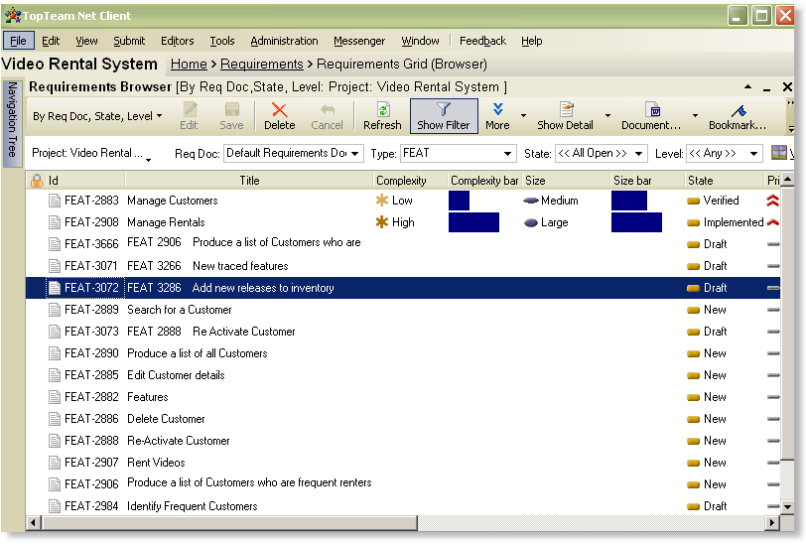
Powerful Requirements Grid – Sort, Group, Summarize by attributes

Slide 39

Requirements Traceability

Slide 40
Need for “Traceability” between Requirements Artifacts
Needs
Features
Use Cases
Modules
Safety
Requirements
Software
Requirements
Test
Cases
Performance
Requirements

Slide 41
Traceability answers these questions
Why do we have to build this feature in the first place? The Reason
If I change this Requirement, what all will get impacted?
Has this Requirement been implemented?
Do we have the Test Cases for this Requirement?

Slide 42
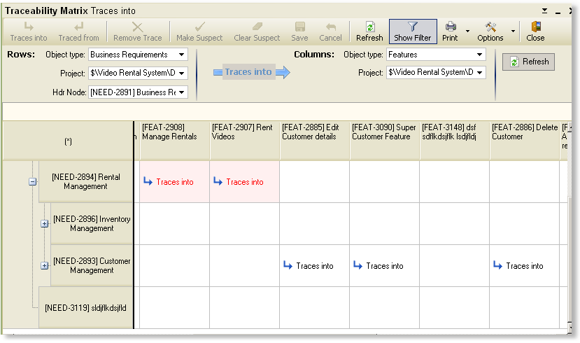
Traceability Matrix Editor

Slide 43
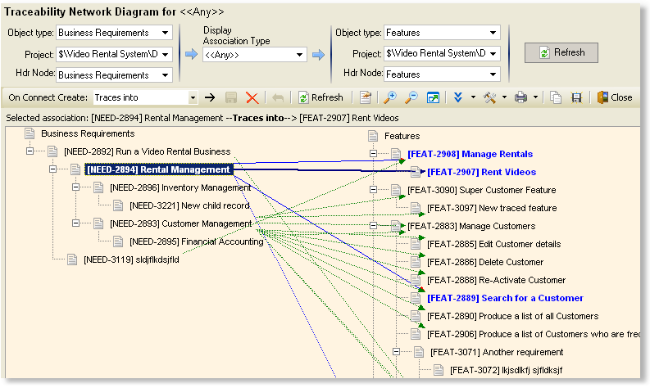
Exclusive Traceability Network Diagram
The easiest way to visualize and maintain Traceability!
Create Trace relationships by simply drawing lines

Slide 44
Demo
Creating Traced Requirement
Creating a Trace Relationship
Split view of Traceability
Traceability Matrix
Trace Network Diagram

Slide 45
Context Diagram

Slide 46
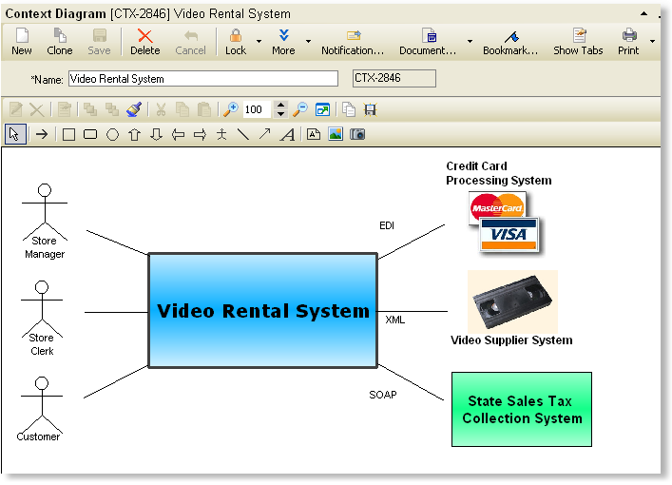
Draw Context Diagrams right inside TopTeam
Explain the scope of the system and its interfaces to all stakeholders

Slide 47
Use Case
Modeling

Slide 48
What is a Use Case?

Slide 49
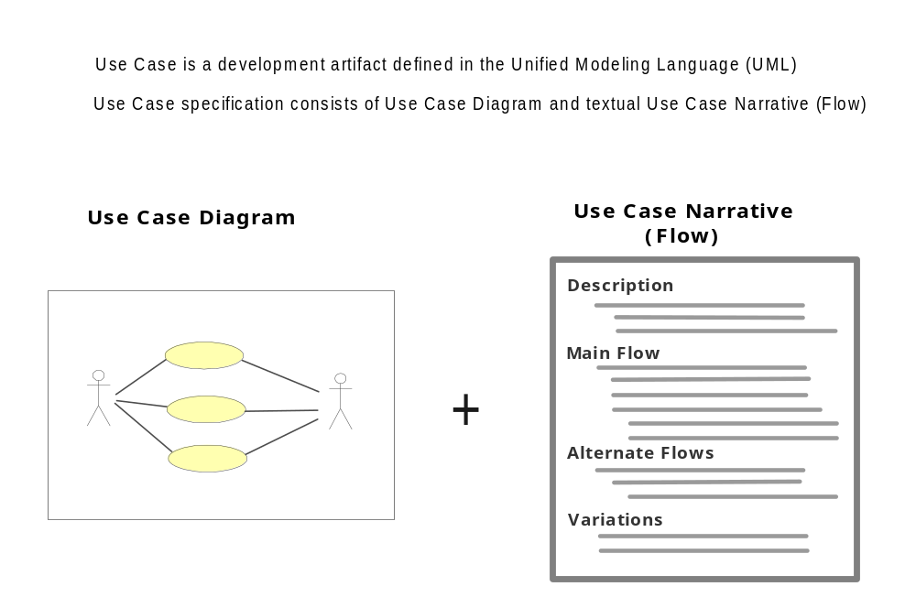
Use Case

Slide 50
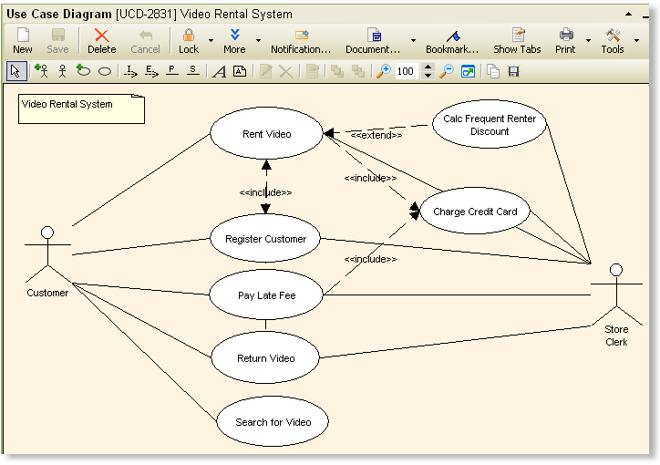
Use Case Diagram Editor

Slide 51
Why Use Cases?

Slide 52
Typical Functional Requirements look like this:
Boring, uninspiring and don’t communicate much!
The system shall allow the store clerk to rent videos to customers
The system shall require customer’s membership number before a video can be rented to him
The system shall display customer’s rental history when the membership number is provided
Whenever a video is rented, the system shall update the inventory to mark the video as rented
The system shall not allow R rated videos to be rented to customers under the age of 18

Slide 53
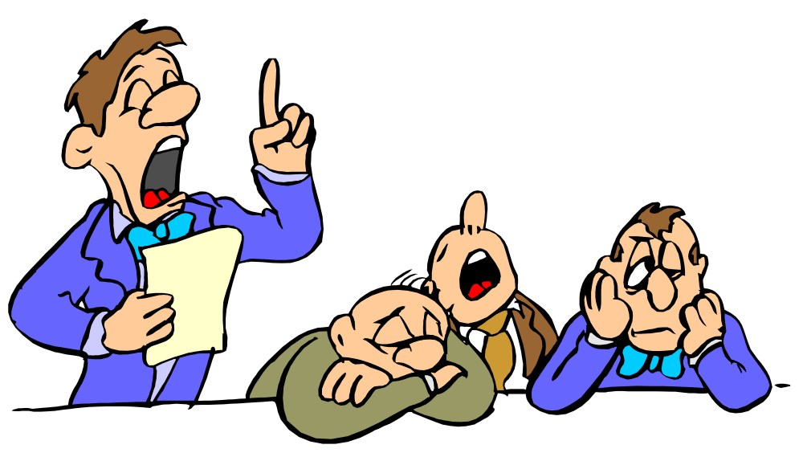
The SRS Document
Boring. Nobody reads it!
The System shall...
The System shall...
The System shall...

Slide 54
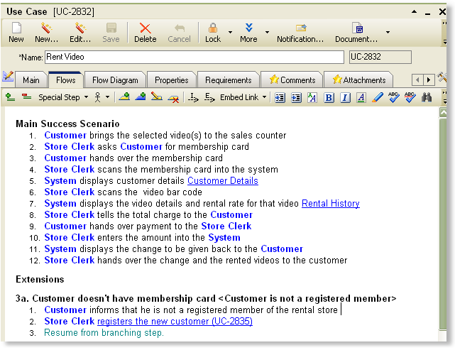
Use Case Flow is a more friendly technique for describing a system’s functionality
(TopTeam’s specialized Use Case Flow Editor shown below)

Slide 55
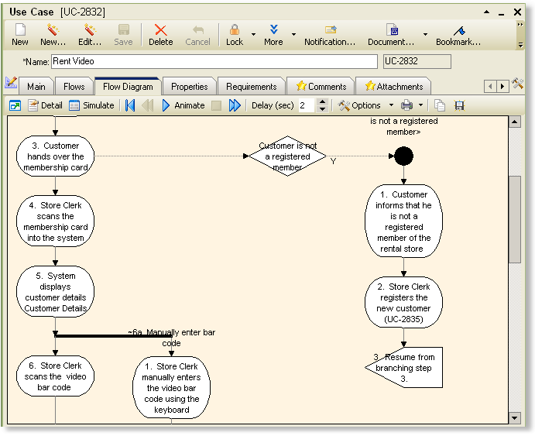
Auto generated “Flow Diagram” from the flow editor
Visualize the Use Case logic!

Slide 56
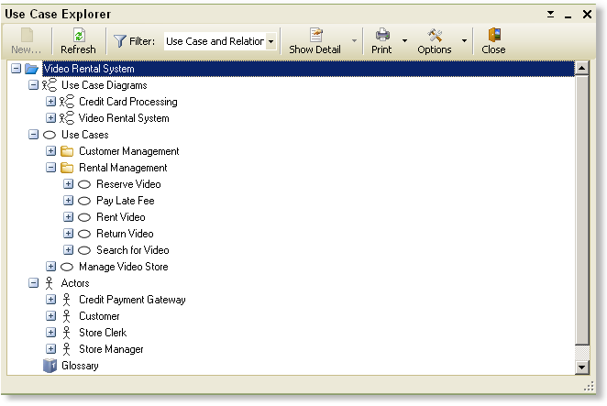
Use Case Explorer

Slide 57
Demo
Use Case Editor
Flow Diagram
Grid
Dashboard
Application Simulation

Slide 58
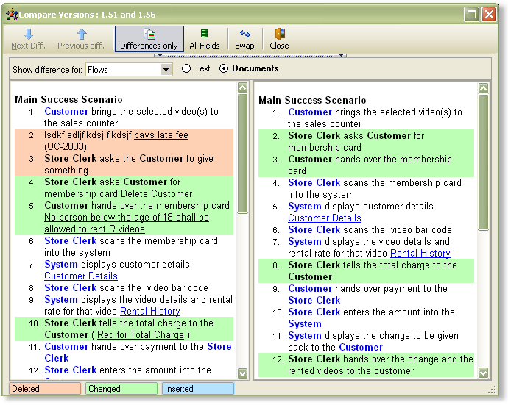
Compare Use Case Versions to view what has changed

Slide 59
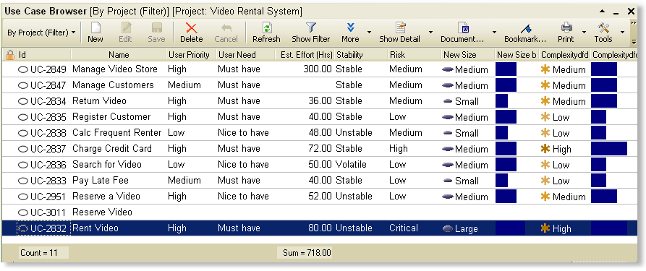
Prioritize, Scope, Weigh and Track Use Cases
using the Use Case Grid

Slide 60
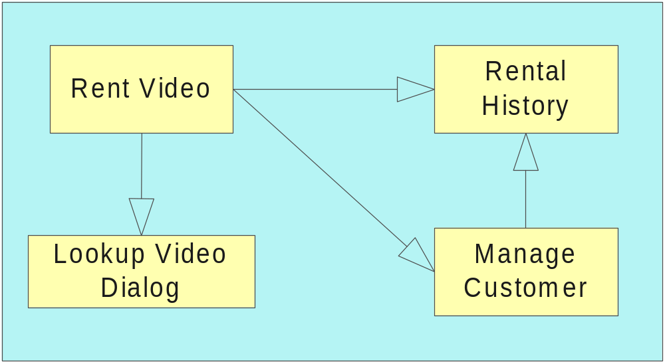
Application Prototyping

Slide 61
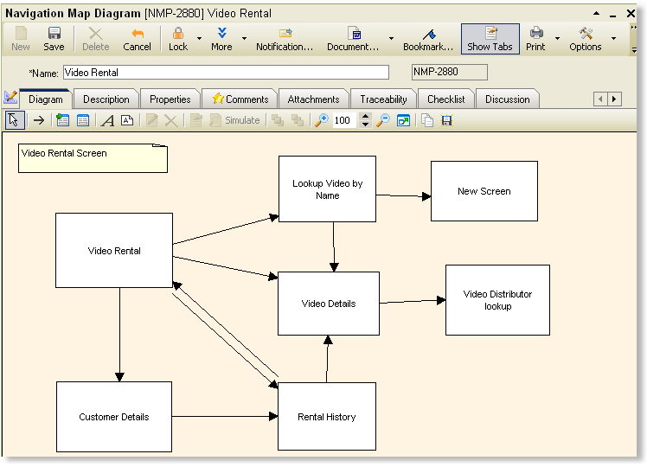
“Screen Navigations Editor”

Slide 62
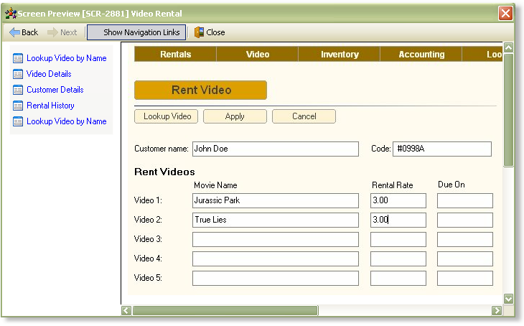
Simulate the system
“Navigation Links” appear automatically based on specified screen navigations

Slide 63
Demo
Screen Navigation Editor
Screen Prototype Editor
System Simulation

Slide 64
Release Management

Slide 65
What is a Release
A Release is a collection of deliverables
A Release can be targeted to a date

Slide 66
Why Manage by Releases
Iterative development
Incremental development
Communicate the goals to the entire team

Slide 67
Release is a container
Repository
Release
Features
Requirements
Use Cases
Forms
Reports
Selected
Repository Objects
Tracking Items
Change Requests
Defects
Feature Requests
Tasks
Issues
Selected
Tracking Items

Slide 68
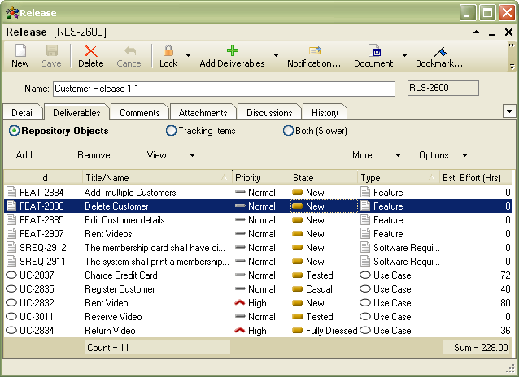
Release Editor
Identify deliverables

Slide 69
Baseline Management

Slide 70
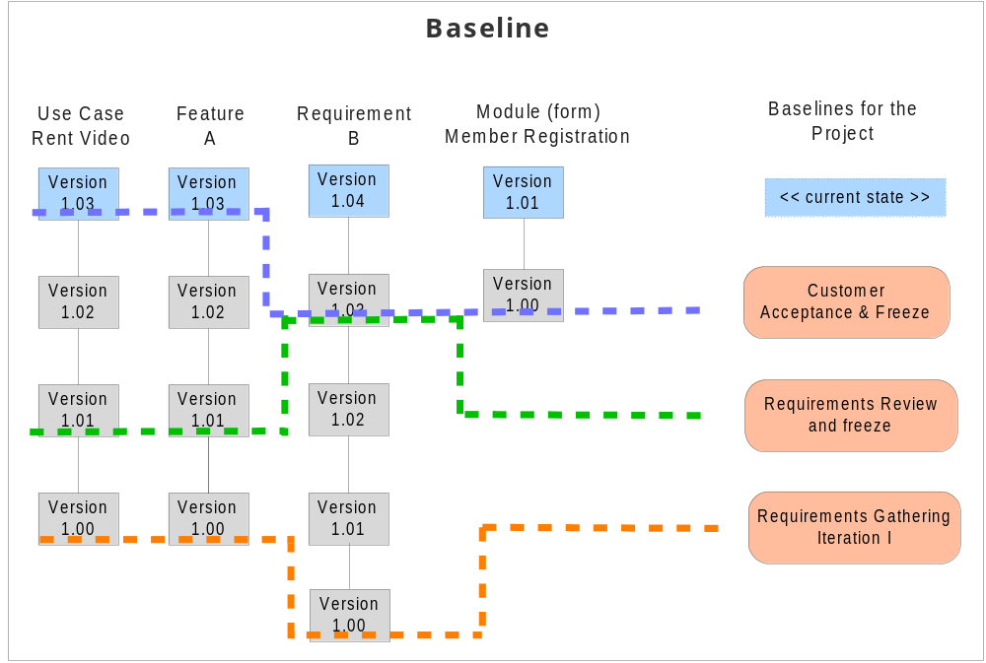

Slide 71
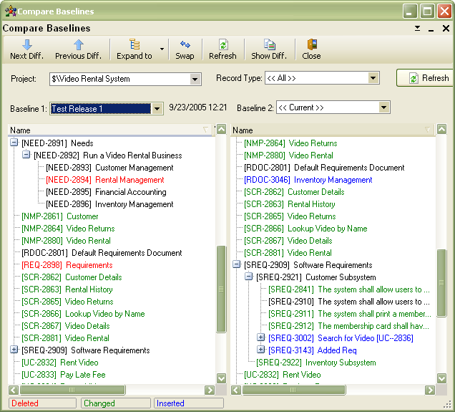
Compare Baselines
To understand exactly what has changed

Slide 72
Document Management

Slide 73
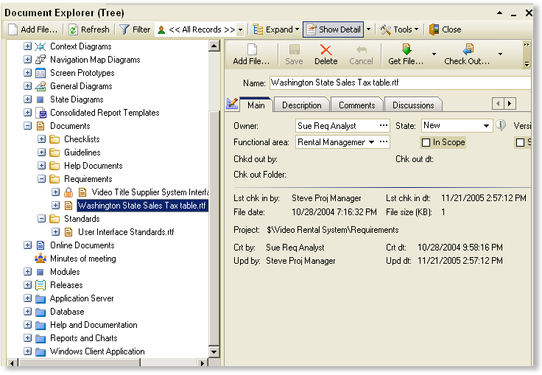
Integrated Document Management - Keep all related documents in TopTeam repository and create Trace relationships to other system elements

Slide 74
TopTeam allows you to build a Complete Requirements Package
Requirements Hierarchy
  Functional Requirements
  Non-Functional Requirements
Traceability Relationships
Use Cases
Context Diagrams
Screen Prototypes
Screen Navigation Diagrams
Related “Documents”, Files
TopTeam allows you to keep ALL of your Requirements artifacts in a central repository

Slide 75
About Us
TechnoSolutions Corp. established 1995
Developing “innovative & user friendly” solutions at the core of company philosophy
In 1996, launched SQL Navigator, a ground breaking tool for Oracle
Thousands of satisfied customers worldwide

Slide 76
TopTeam Analyst
A unique Requirements solution
Thank You
For further information:
1-877-20-TOPTEAM
1-360-260-0710
info2005@TechnoSolutions.com
www.TechnoSolutions.com
TechnoSolutions Confidential.
Not for public distribution without express permission.

